Slide 1
Business card

Slide 2
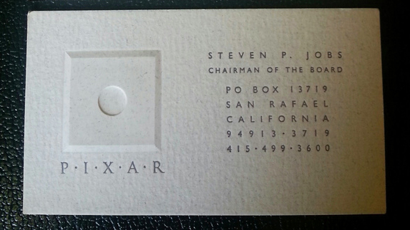
Example of Steve Jobs’ card

Slide 3
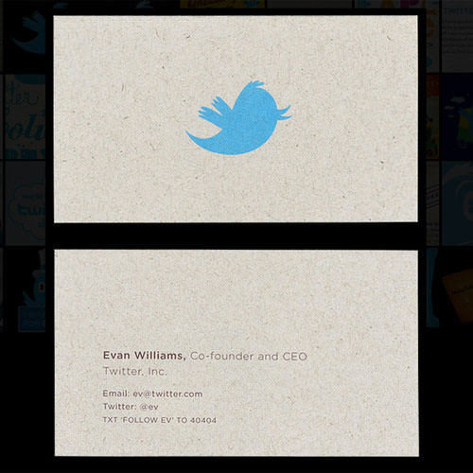
Example of Evan Williams’ card

Slide 4
Our business card design
Refer to the design of Williams’ card, the words “What’s production”*** will be printed on one of the sides
***the words “What’s production” should be concave like this
***What’s production
here

Slide 5
Our business card design
Product Range:
Bags
Premium
Caps
Tie
Mascot
Cups
Another side
Contact information

